Slide 1

Computer Communications
& Networks
CSNC-2413
Lec: 6
Computer Networking: A Top Down Approach
6th edition
Jim Kurose, Keith Ross
Addison-Wesley
March 2012
Ch-2 Appl layer, Appl development
& UDP Client-Server
Dr Nauman Mazhar
Faculty of Information Technology (FIT)
University of Central Punjab (UCP)

Slide 2
Chapter 2: outline
2.1 Principles of network applications
2.2 Web and HTTP
2.3 FTP
2.4 Electronic mail
  SMTP, POP3
2.5 DNS
2.6 P2P applications
2.7 Socket programming with UDP and TCP

Slide 3
Chapter 2: application layer
Our goals:
Conceptual & implementation aspects of network applications
Application architectures
  client-server
  peer-to-peer
Applications & services
  services reqd by appl
  services available
Learn about protocols by examining popular application layer protocols
  HTTP, FTP
  SMTP / POP3
  DNS
Network applications development
  sockets

Slide 4
Some network apps
e-mail
web surfing
search engine
P2P file sharing
text messaging
social networking
remote login
streaming stored video
(YouTube, Netflix)
IP radio, TV
multi-user N/W games
voice over IP
(Skype, viber)
real-time video conferencing
…..
Appls require different types of services from the N/W…

Slide 5
Internet protocol stack
Recall the 5 layer Internet Protocol Architecture
  lower layer provides services to the higher layer
All applications exist at the “Application” layer…
  Transport layer provides services to the Application layer
application
transport
network
link
physical

Slide 6
Apps & Transport layer
Apps require different types of services from Transport layer
  “different types of Transport Layers are available”
  developer can select the services by choosing relevant
  transport layer
Once transport layer is selected…
“appl built by using only the services provided
by that protocol”
Developer has full control over appl functionality, but little
over transport layer…
  may set few transport level params
  (max segment size, etc)

Slide 7
Services provided by Transport layer
TCP service:
reliable transport: between sending & receiving process
connection-oriented: setup required between client & server
flow control: sender won’t overwhelm receiver
congestion control: throttle sender when network overloaded
does not provide: timing, min thruput guarantee, security
UDP service:
unreliable data transfer: between sending & receiving process
does not provide: reliability, connection setup, flow control, congestion control, timing/thruput guarantee, or security
Q: why bother?
why is there a UDP?

Slide 8
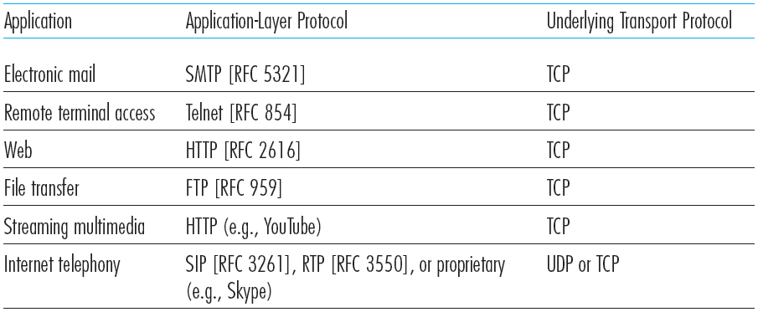
Common Internet apps & transport protocols
Popular Internet applications, their application-layer protocols, and their underlying transport protocols

Slide 9
Services required by Apps
Reliable data Tx
Service where data
is to be delivered
correctly & completely
pkts may be lost; bit errors, router buffer overflows
Loss intolerant apps:
some apps require reliable data transfer
(email, file transfer, web)
Loss tolerant apps:
other apps can tolerate some loss (audio, video)
Thruput
Service where guaranteed thruput is required
(R bps)
B/W intensive apps:
some apps require min thruput to be “effective”
(IP telephony, video)
Elastic apps:
other apps use whatever thruput is available
(web, email, file transfer)

Slide 10
Services required by Apps
Timing
Service where data may require delivery within some specified max delay
Interactive real time apps: have tight delay constraints
(IP telephony, teleconference, Internet games)
Non-real time apps:
can tolerate delays
but lower delay is preferred
Security
Service where certain protection may be required
(using encryption)
Confidentiality: data not disclosed to un-authorized user
Data integrity: data not modified maliciously
Source authentication: source is really who he claims

Slide 11
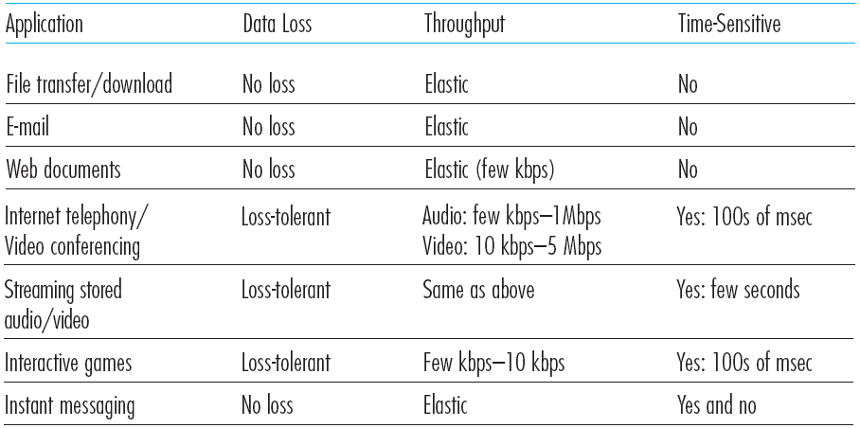
Transport services required: Common apps

Slide 12
Apps & App-layer protocols
Difference between Apps & App-layer protocols
  App-layer protocol is a component of an application
Application layer protocols define…
  Types of messages exchanged:
  request, response
  Message syntax:
  what fields in msgs & how fields are delineated
  Message semantics:
  meaning of information in fields
  Rules:
  when & how processes send & respond to msgs

Slide 13
App-layer protocols
Open protocols:
defined in RFCs, allow for interoperability
e.g, HTTP [RFC 2616], FTP [RFC 959]
Proprietary protocols:
e.g, Skype, MS Exchange Server protocols

